Slide 1
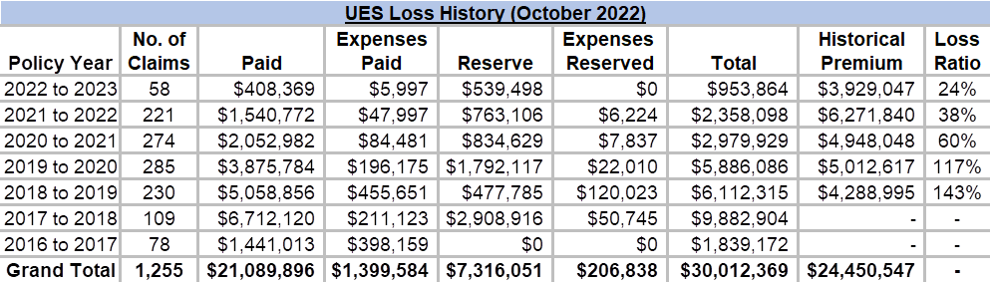
Current UES (including acquired entities) loss history
Past three years show a continued trend of lower losses
UES is in a good position to take on high reward Captive Program based on loss mitigation efforts
UES has improved RM and Safety efforts: Fleet and new hire safety initiatives, training, Geotab implementation

Slide 2
Captive Considerations
UES’s 22/23 projected ultimate cost for losses within the Everest deductibles is $2.46M with $476k in paid claims and $1.98M in incurred but not reported (IBNR) losses
UES expects the 23/24 loss projections to be around $3.56M based on most recent company claims performance and growth adjustment
If UES joins the Olympus Group Captive and has $3.56M in losses, the savings compared to staying with Everest are ~$2,165,953
If losses turn out to be as expected by the conservative Captive actuaries ($5.1M), UES still saves ~$1,456,273 compared to staying with Everest
Even at the highest projected losses, staying with the Everest program doesn’t make UES better off. Everest’s program has unlimited loss potential for UES (no deductible cap) whereas the Captive has a known maximum cost of $11.7M
If UES performs as expected with favorable losses, the Captive future pricing will reflect rate decreases. The Captive prices UES based on its own loss history merits for the past five years. Traditional insurance prices coverage on a book portfolio basis and rate decreases are not realistic in this current insurance hard market environment

Slide 3
Captive Considerations (continued)
Better claims performance allows UES to generate investment income on unused premiums with returned dividends due in the future, reducing insurance cost at time of recap in 4 to 5 years
Captive typically close claims at five years after completion of the policy period. Partial dividend distributions start as early as two to three years depending on Captive performance
The group captive offer an aggregate maximum for losses within the deductible if losses are much higher than expected. Everest and Liberty do not offer a cap.
Captive fixed costs of $2.485M are considerably lower than either Everest renewal option—$4.985M or $4.437M.
Pay up-front Captive Collateral requirement: 50% of the unadjusted A fund for 3 years. After that, required collateral is adjusted based on 150% of current A fund against the average past three years posted collateral. Traditional insurance requires collateral every year for open policy terms and the amounts stack up. Refer to exhibits on next slide

Slide 4
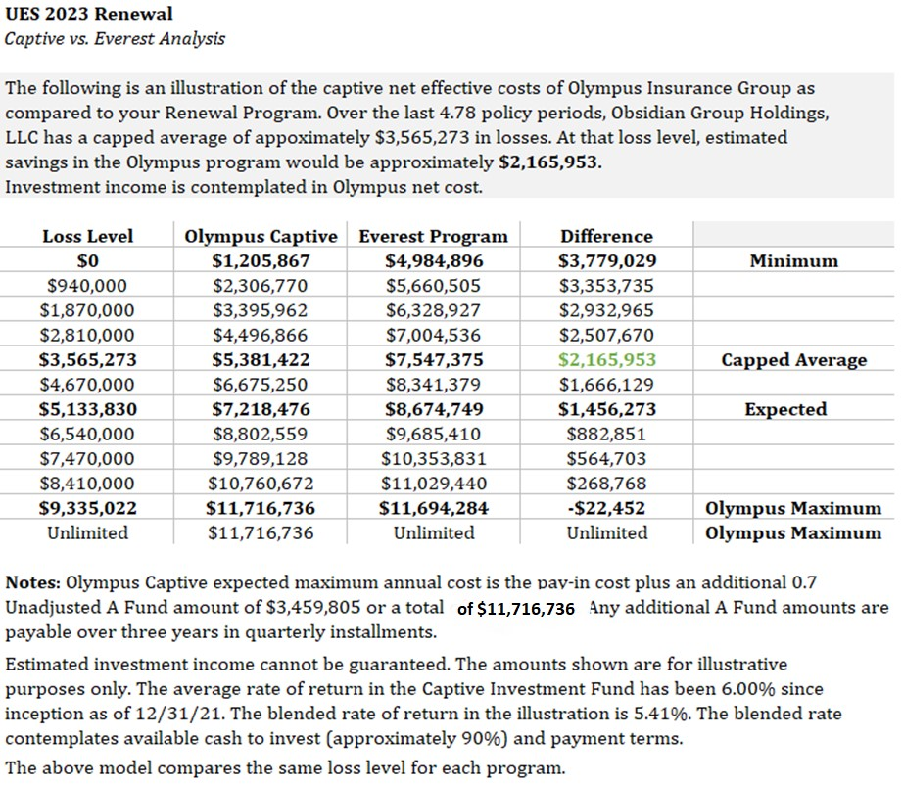
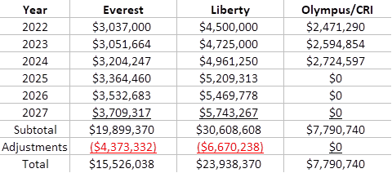
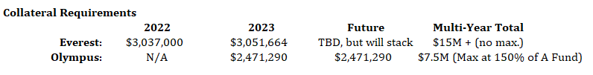
Captive Considerations (continued)
Collateral Look Ahead Comparison (illustration purposes)

Slide 5
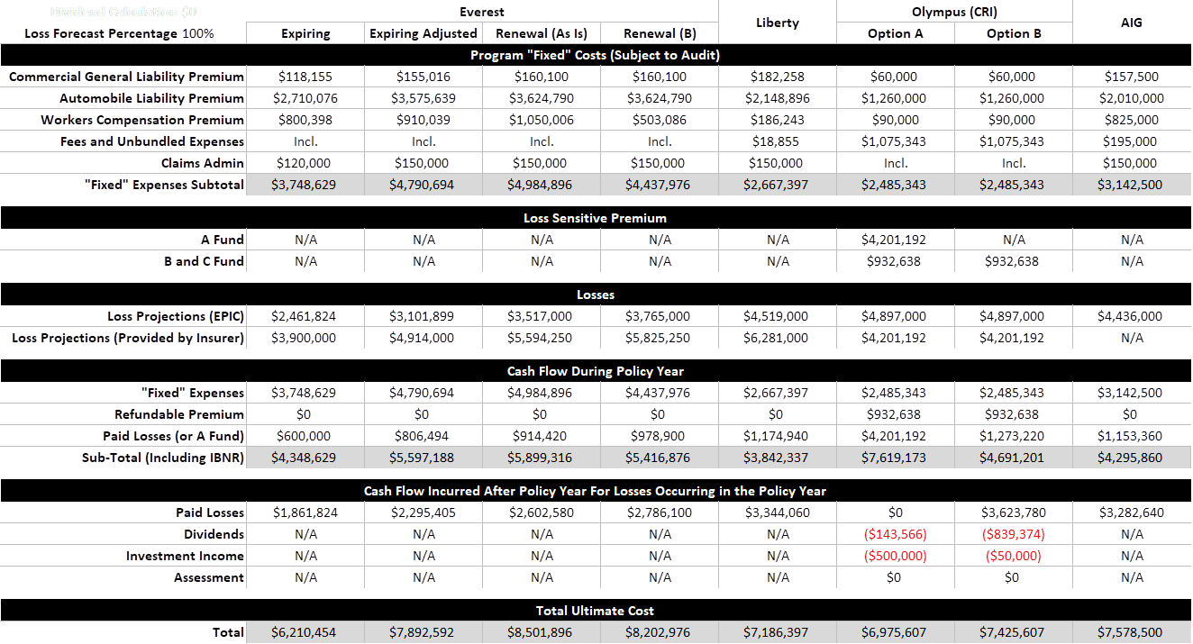
23/24 Renewal Overall Options for General Liability, Workers Compensation, and Auto Liability

